Slide 1
VIRTUAL REALITY
PRESENTED
BY
ESHAL KHAN

Slide 2
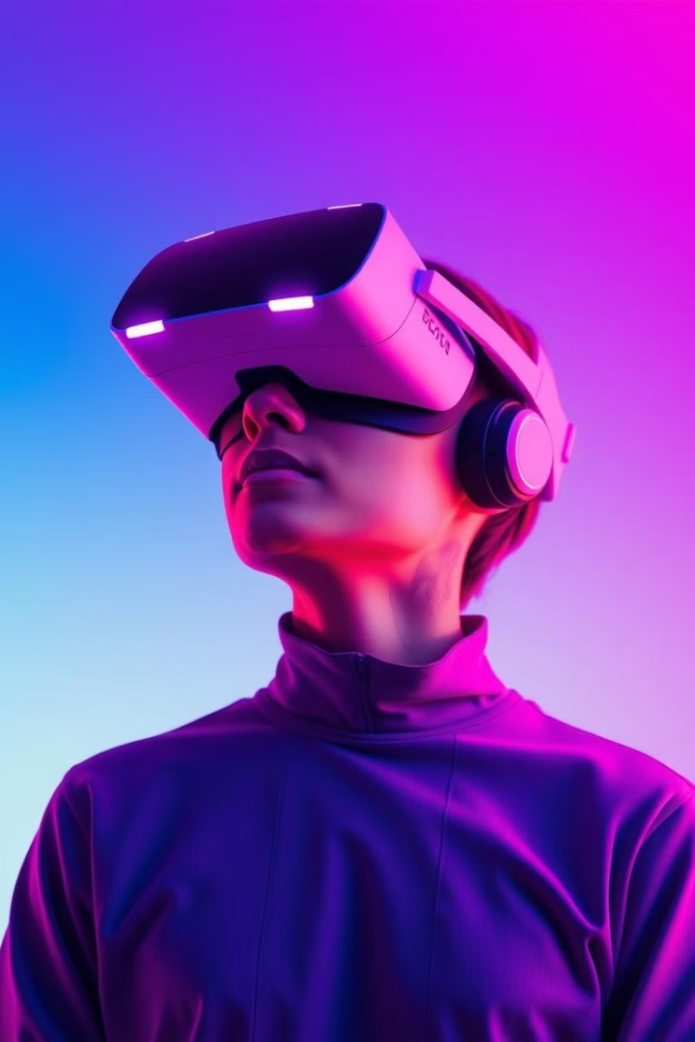
The Future of Interaction: Virtual Reality
Virtual reality (VR) has emerged as a transformative technology, revolutionizing how we interact with the digital world.

Slide 3
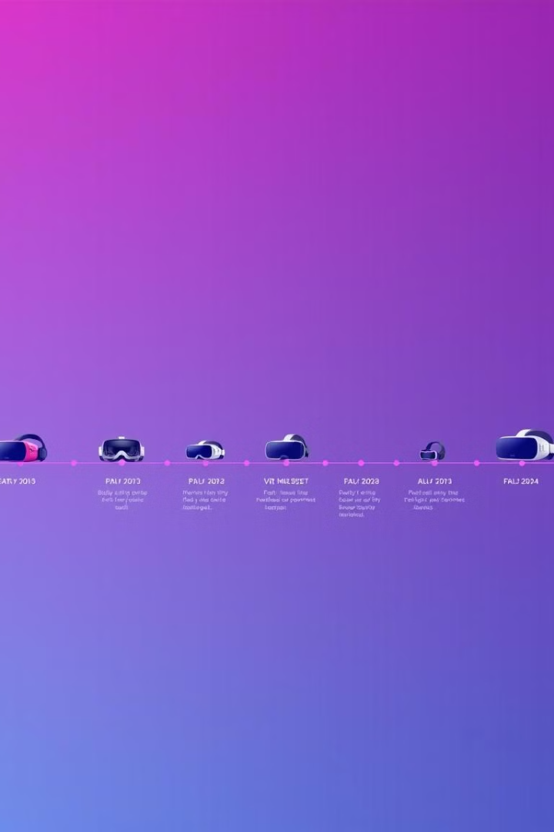
History and Evolution of VR
1
Early concepts of VR emerged in the 1950s, with Morton Heilig's Sensorama simulator.
2
The 1960s saw the development of head-mounted displays (HMDs), like the Sword of Damocles.
3
The 1990s saw the rise of immersive VR experiences, like the Sega VR headset.
4
The 2010s witnessed a resurgence of VR with consumer-focused devices like Oculus Rift.

Slide 4
Key Components of VR Systems
Headset
Controllers
Sensors
Tracking Technology
Displays a 3D virtual environment and allows for head tracking.
Enable user interaction with the virtual world.
Track the user's position and movements.
Ensures accurate positioning and interaction within the VR environment.

Slide 5
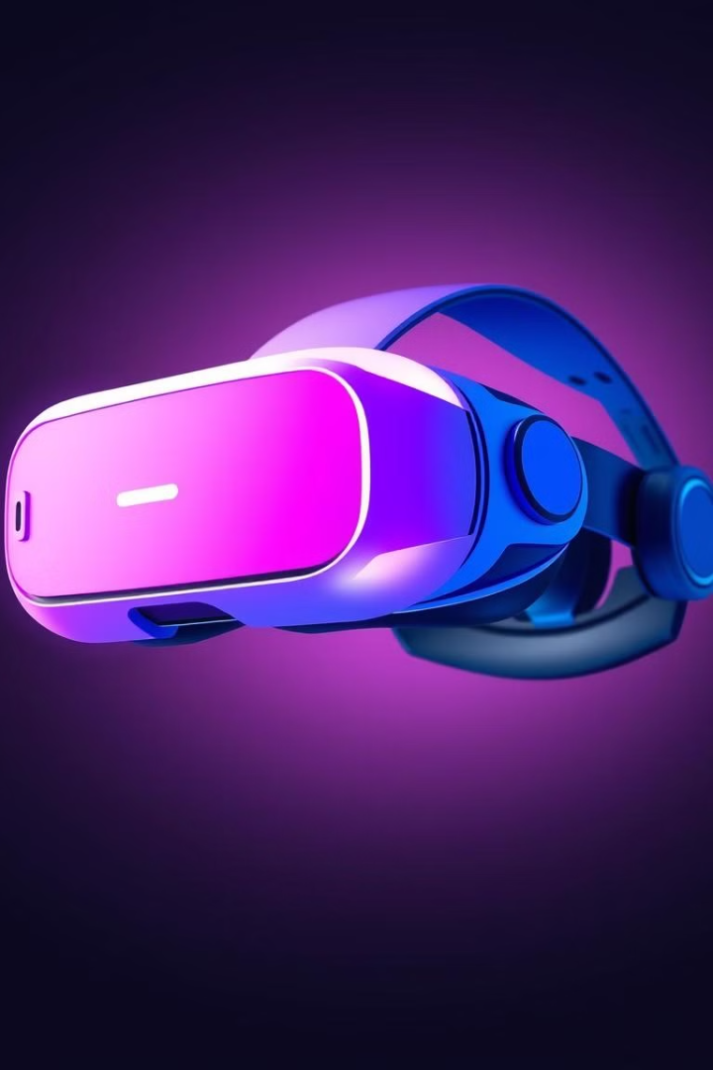
Advancements in VR Technology
1
Higher Resolution Displays
2
Improved Tracking Accuracy
Provide sharper and more realistic visuals.
Enables more precise movements and interactions within the VR environment.
3
Haptic Feedback Technology
4
Wireless Connectivity
Creates a more immersive experience by simulating touch and physical sensations.
Eliminates cables and enhances freedom of movement.

Slide 6
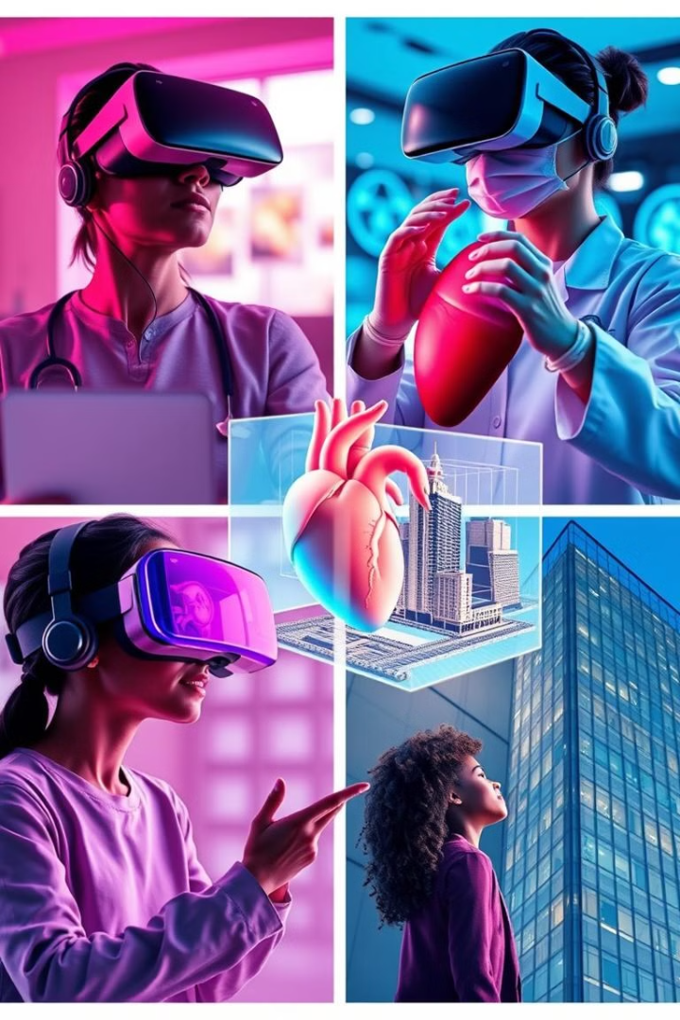




Applications of VR in Various Industries
Gaming
Healthcare
Provides immersive and interactive gaming experiences.
Used for training medical professionals, conducting virtual surgeries, and treating phobias.
Education
Architecture
Offers interactive learning environments and simulations.
Allows clients to experience virtual walkthroughs of buildings before construction.

Slide 7





Challenges and Limitations of VR
1
Cost
Accessibility
2
High cost of equipment limits access for many.
Content Availability
3
Limited selection of high-quality VR content.
Health and Safety
4
Potential for motion sickness, eye strain, and cognitive fatigue.
Social Disconnect
5
Overuse can lead to isolation from real-world social interactions.

Slide 8
The Future of VR and Societal Impact
Enhanced Reality
1
Blending virtual and real-world experiences.
Personalized Education
2
Creating immersive and engaging learning environments.
Remote Collaboration
3
Enabling virtual meetings and shared experiences.
Transformative Industries
4
Revolutionizing industries like healthcare, manufacturing, and entertainment

Slide 9
THANK YOU

